Slide 1
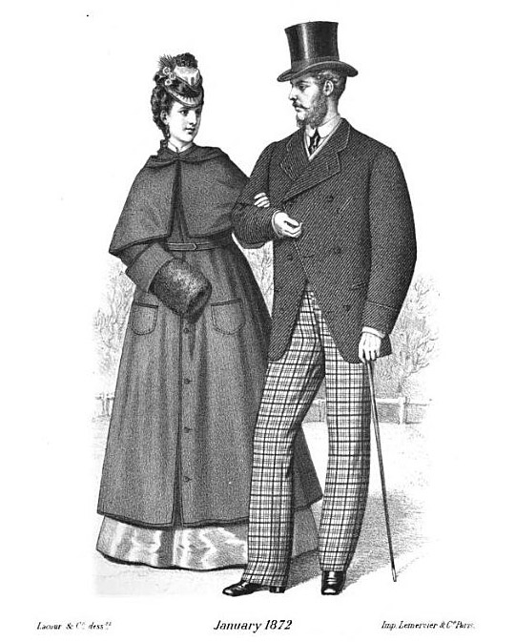
North Manchester Downtown Revitalization

Slide 2
Topics To Be Covered
History
Justification and Benefits
Financing
Project Elements
Construction Challenges
Timeline

Slide 3

Downtown Revitalization - A Little History
14 Years in the making

Slide 4
Project Area
Main Street from Market to Mill
Walnut Street from Main to 2nd

Slide 5
Justification & Benefits
Deterioration of sidewalks – Public Safety
INDOT will not financially support – INDOT “Right of Way”
Economic development
Broken Windows Theory – Wilson & Kelling
Success attracts or breeds success

Slide 6
Financing
Public Safety Complex paid off end of 2013
Wrap-around loan on Public Safety
Tax Free bonds $1.76 million @ 2%
No property tax increase, may decrease slightly
$400,000 for Façade Restorations

Slide 7


Slide 8
Project Elements
Street Lights
Automatic Signals
Sidewalks, Pavers and Steps
Landscaping and Trees
Wayfinding Signs
New Waterlines
WiFi
New Sound System

Slide 9
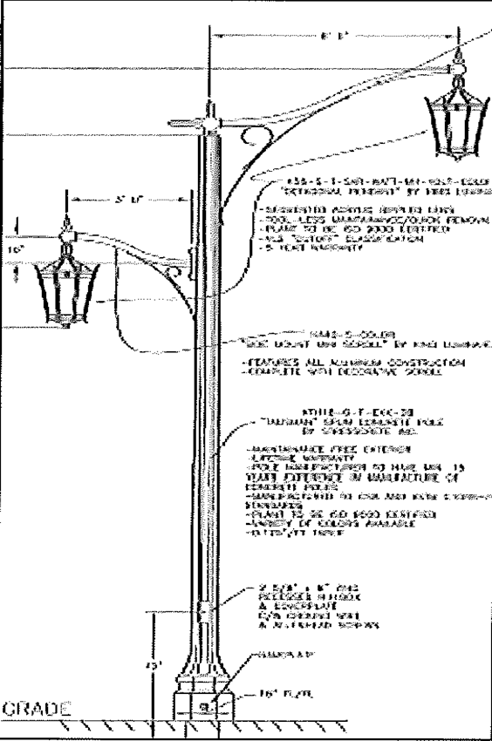
Street Lights

Slide 10
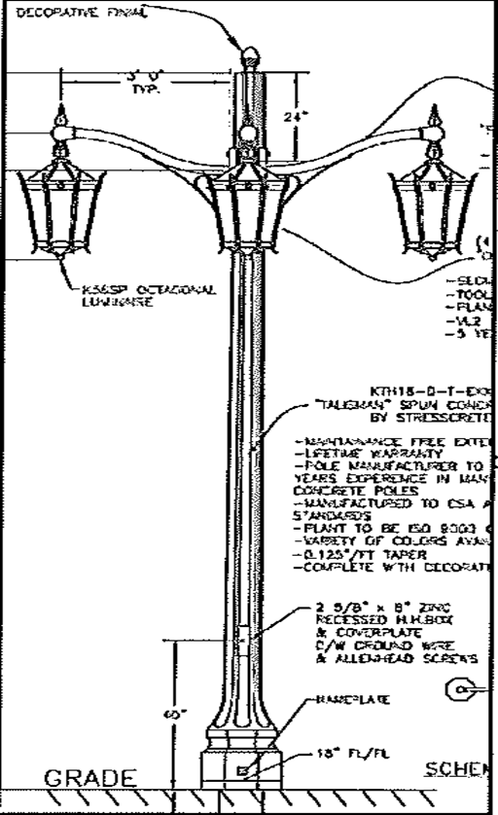
Walnut Street Corner Light

Slide 11
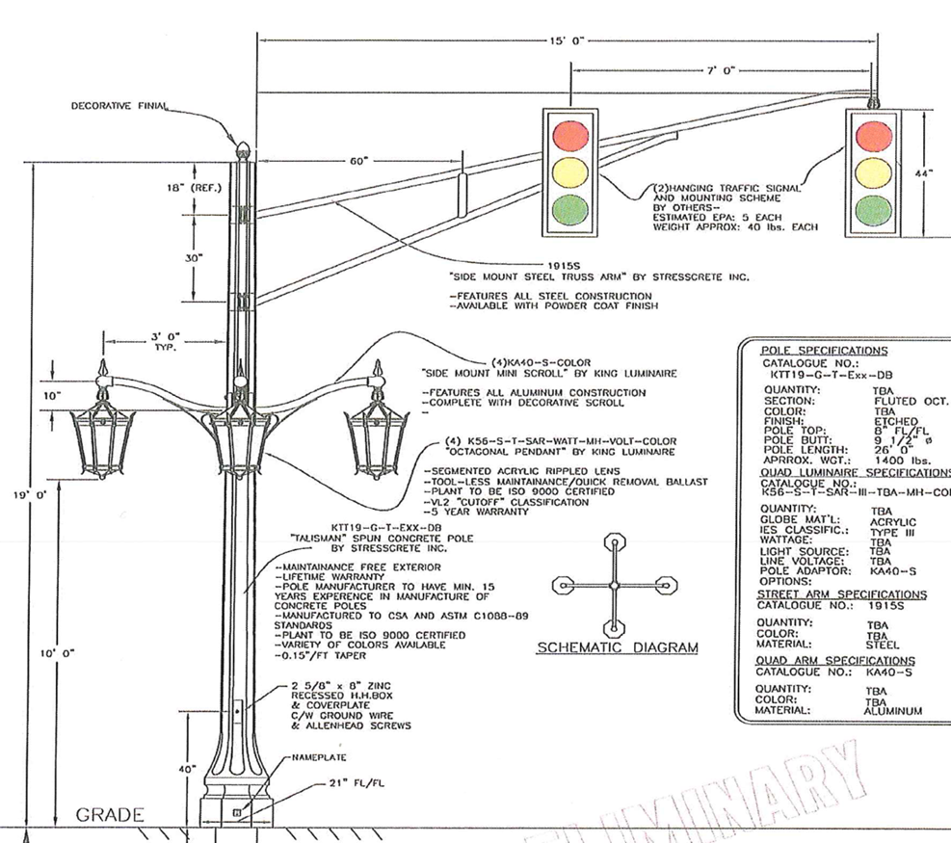
Automatic Signals

Slide 12
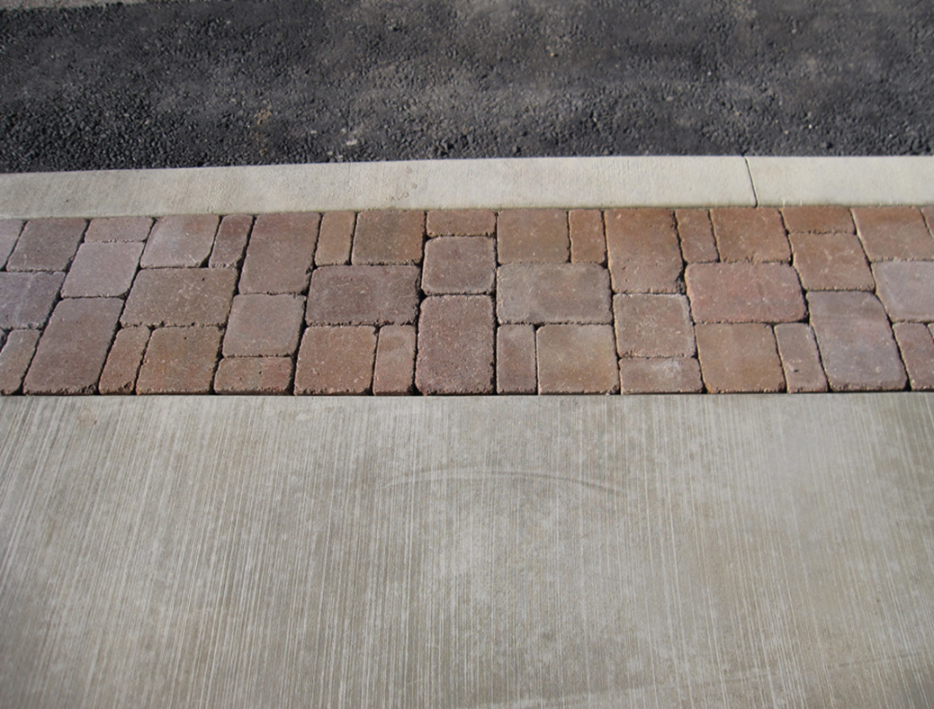
Pavers, Sidewalks and Steps

Slide 13
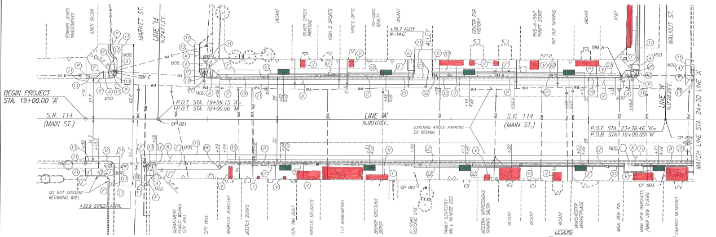
Landscaping Beds and Trees
Trees and Grates

Slide 14
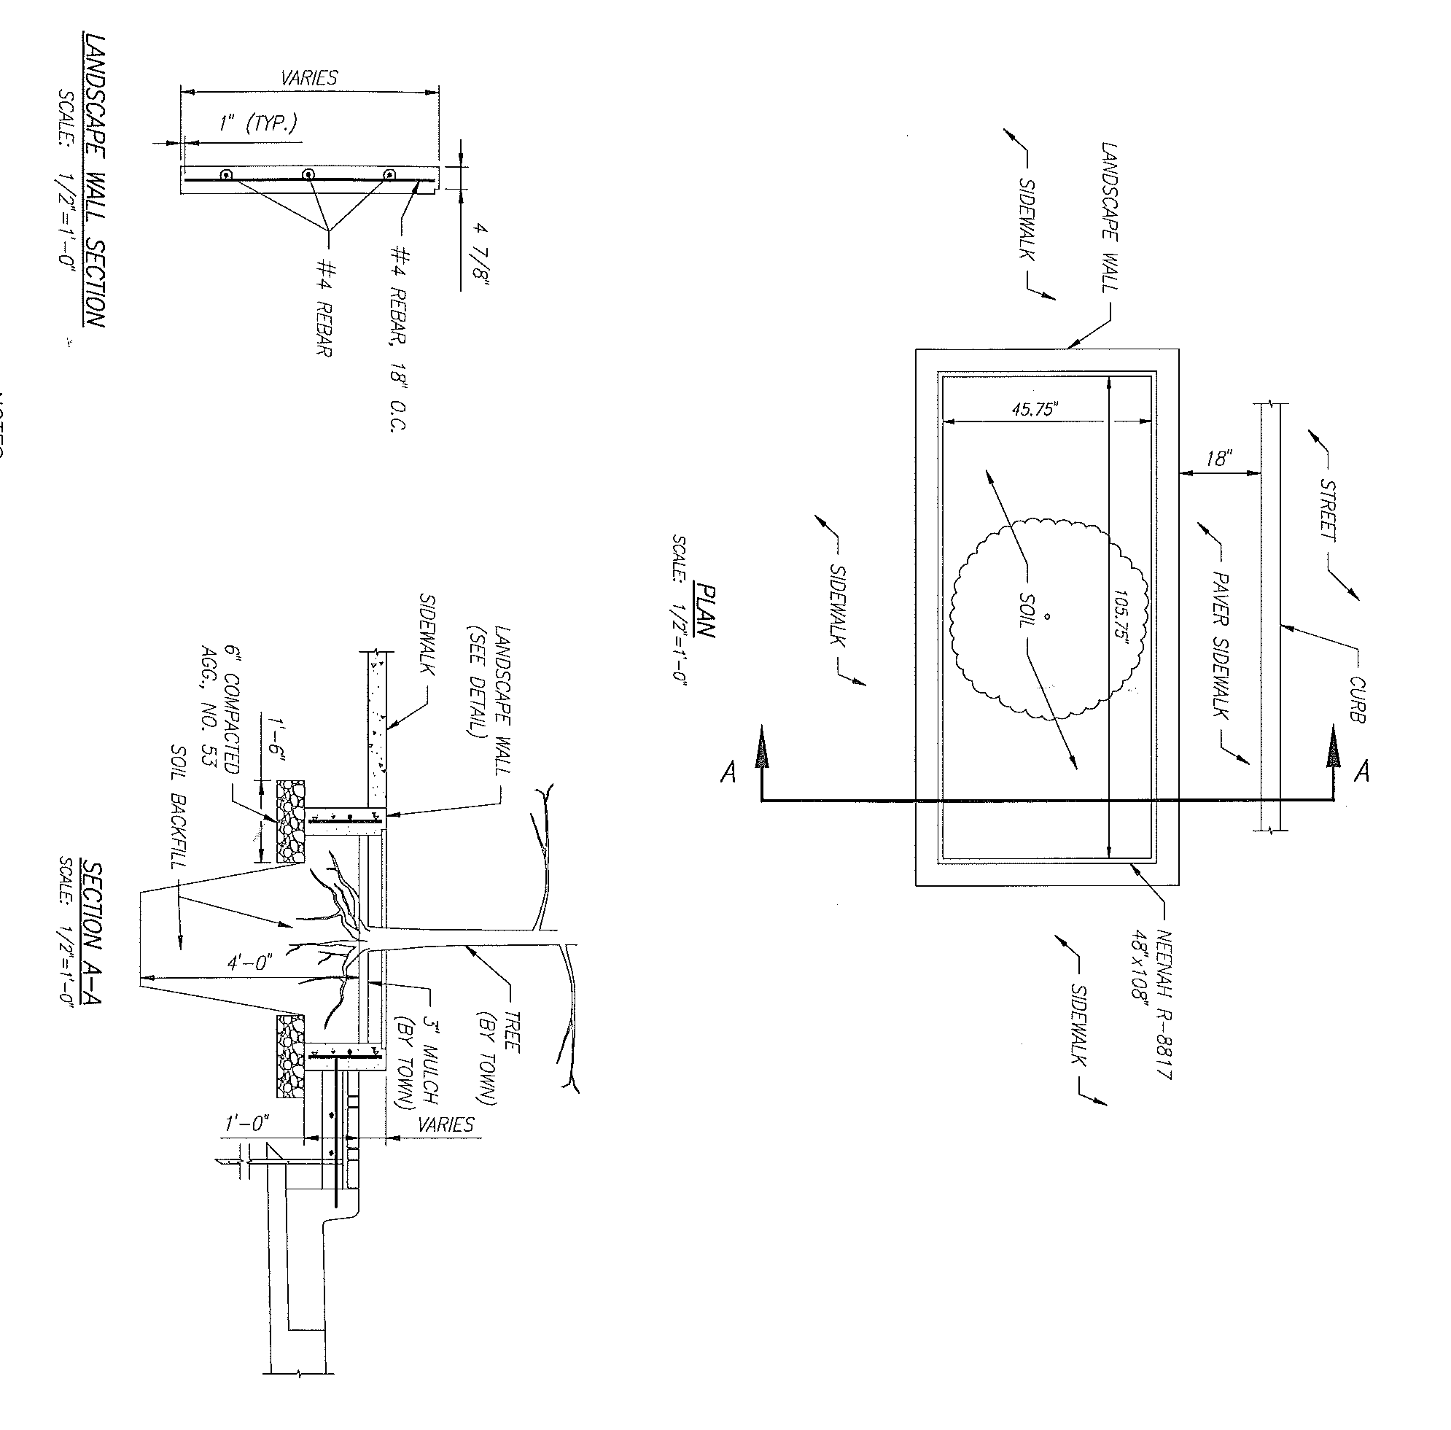
Landscaping Beds

Slide 15
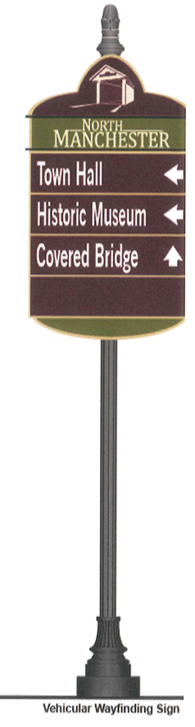
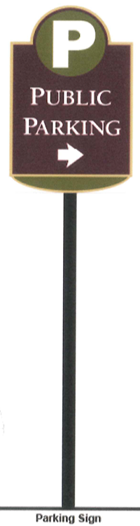
Wayfinding Signs

Slide 16
Wayfinding Sign Locations
SR 114 and Wayne Street
SR 114 and Market Street
SR 13 and SR 114 (2 signs)
SR 13 and Market Street (2 signs)
2 Public Parking Signs

Slide 17
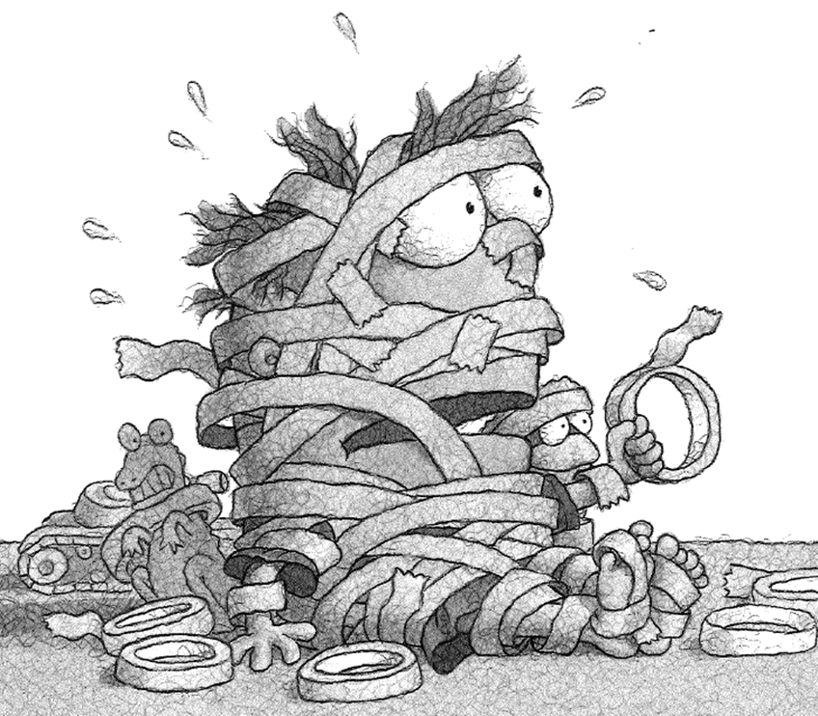
Construction Challenges

Slide 18
Challenges
Vaults, coal chutes, and mysteries under the sidewalks
Building elevations and entrances
Curb heights
Customer access to retail establishments during construction

Slide 19
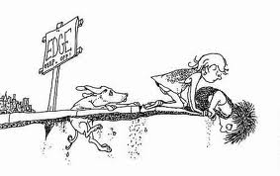
Where the sidewalks end

Slide 20
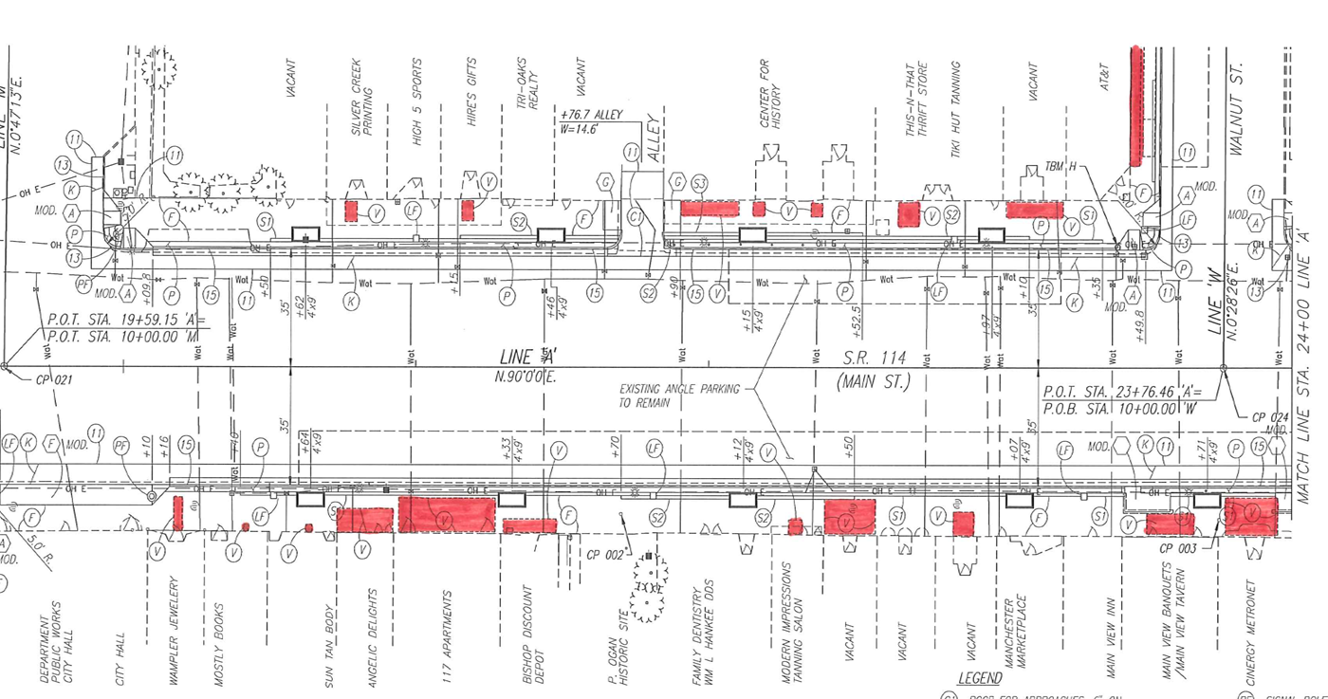
Mysteries Under the Sidewalks
Vaults and Coal Chutes in RED

Slide 21
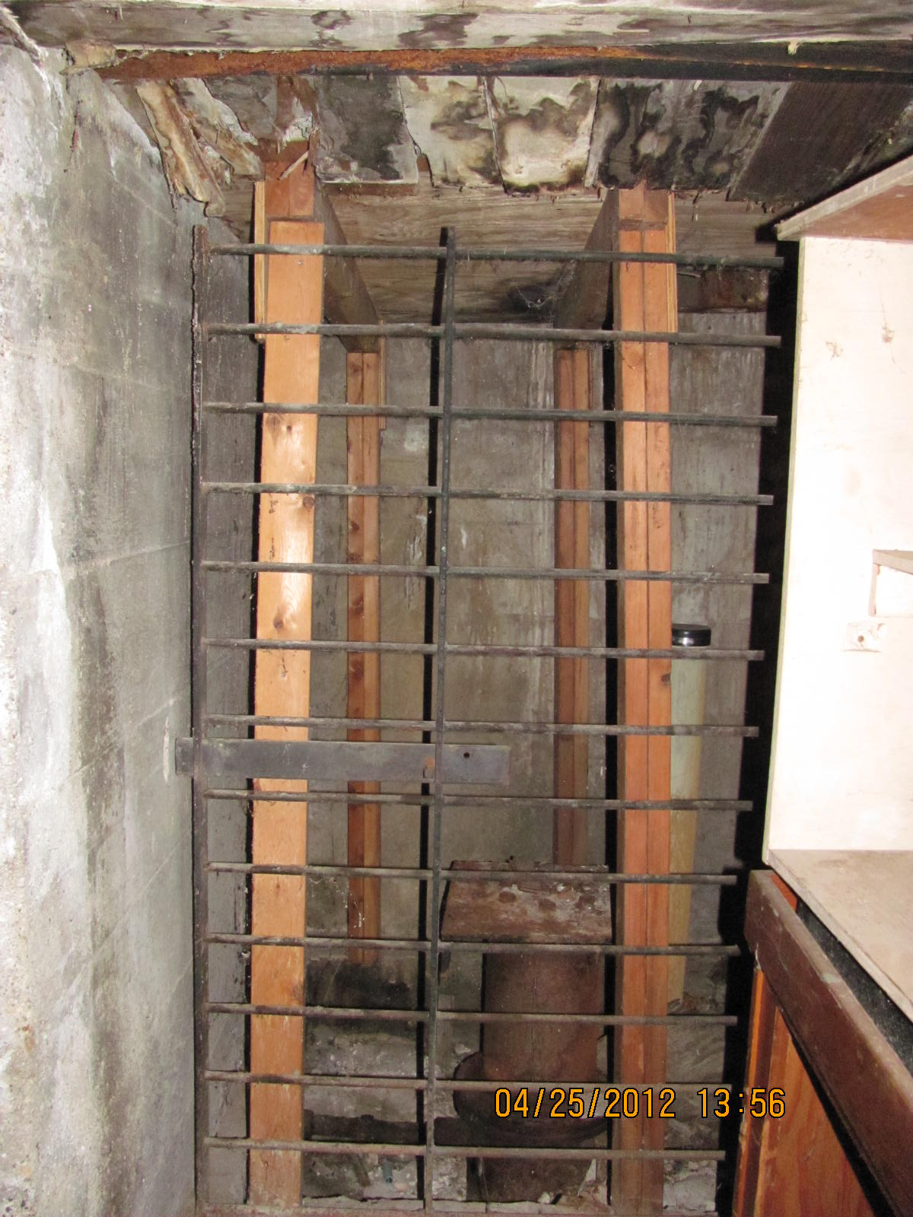
Mysteries Under the Sidewalks

Slide 22
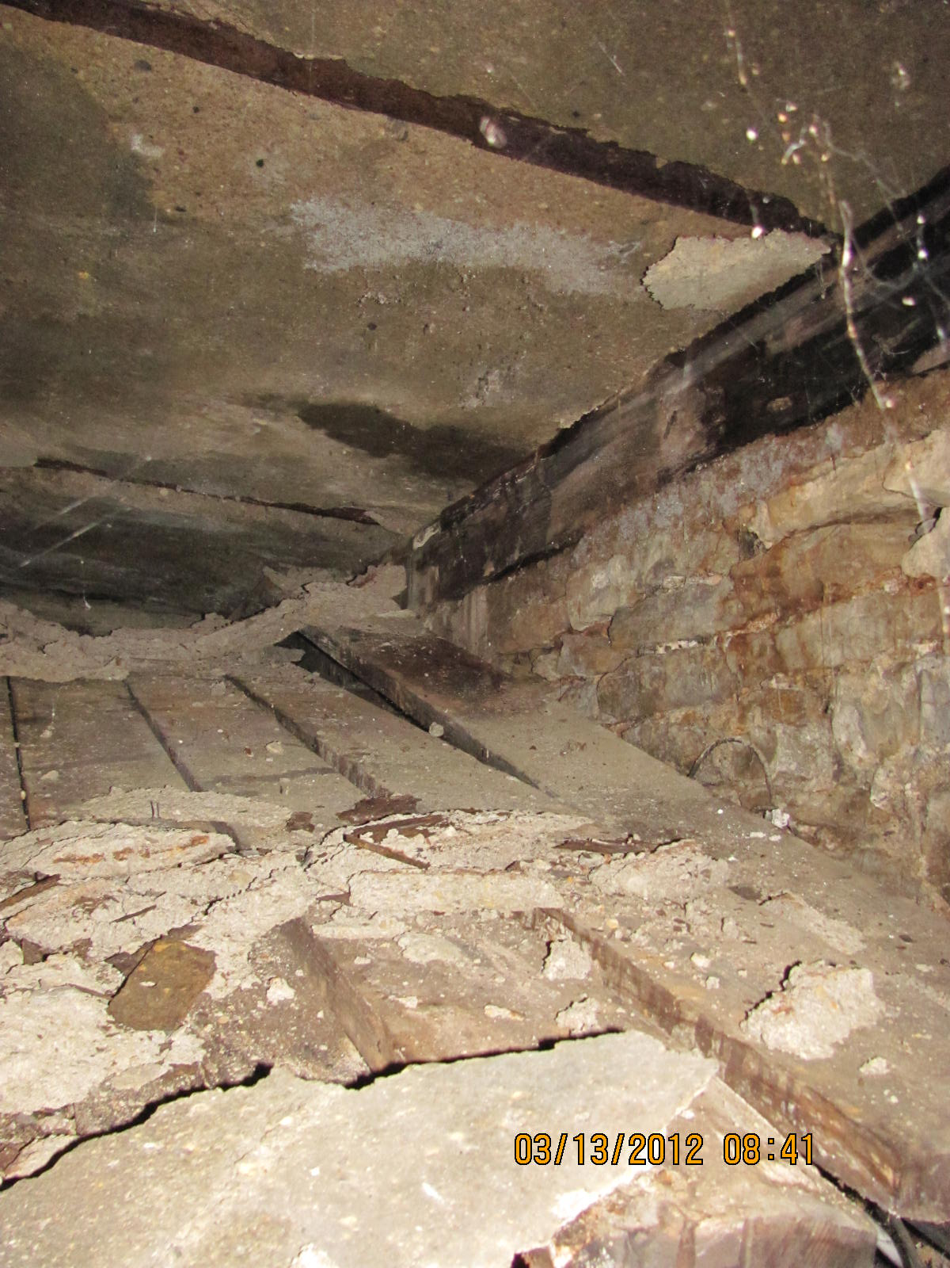
Mysteries Under the Sidewalks

Slide 23
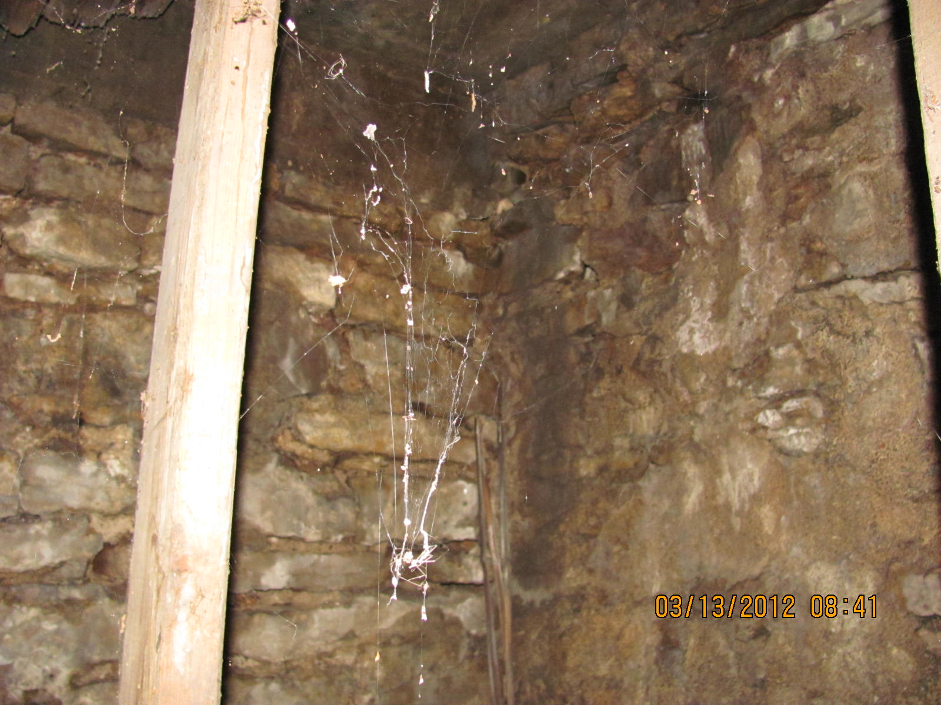
Mysteries Under the Sidewalks

Slide 24
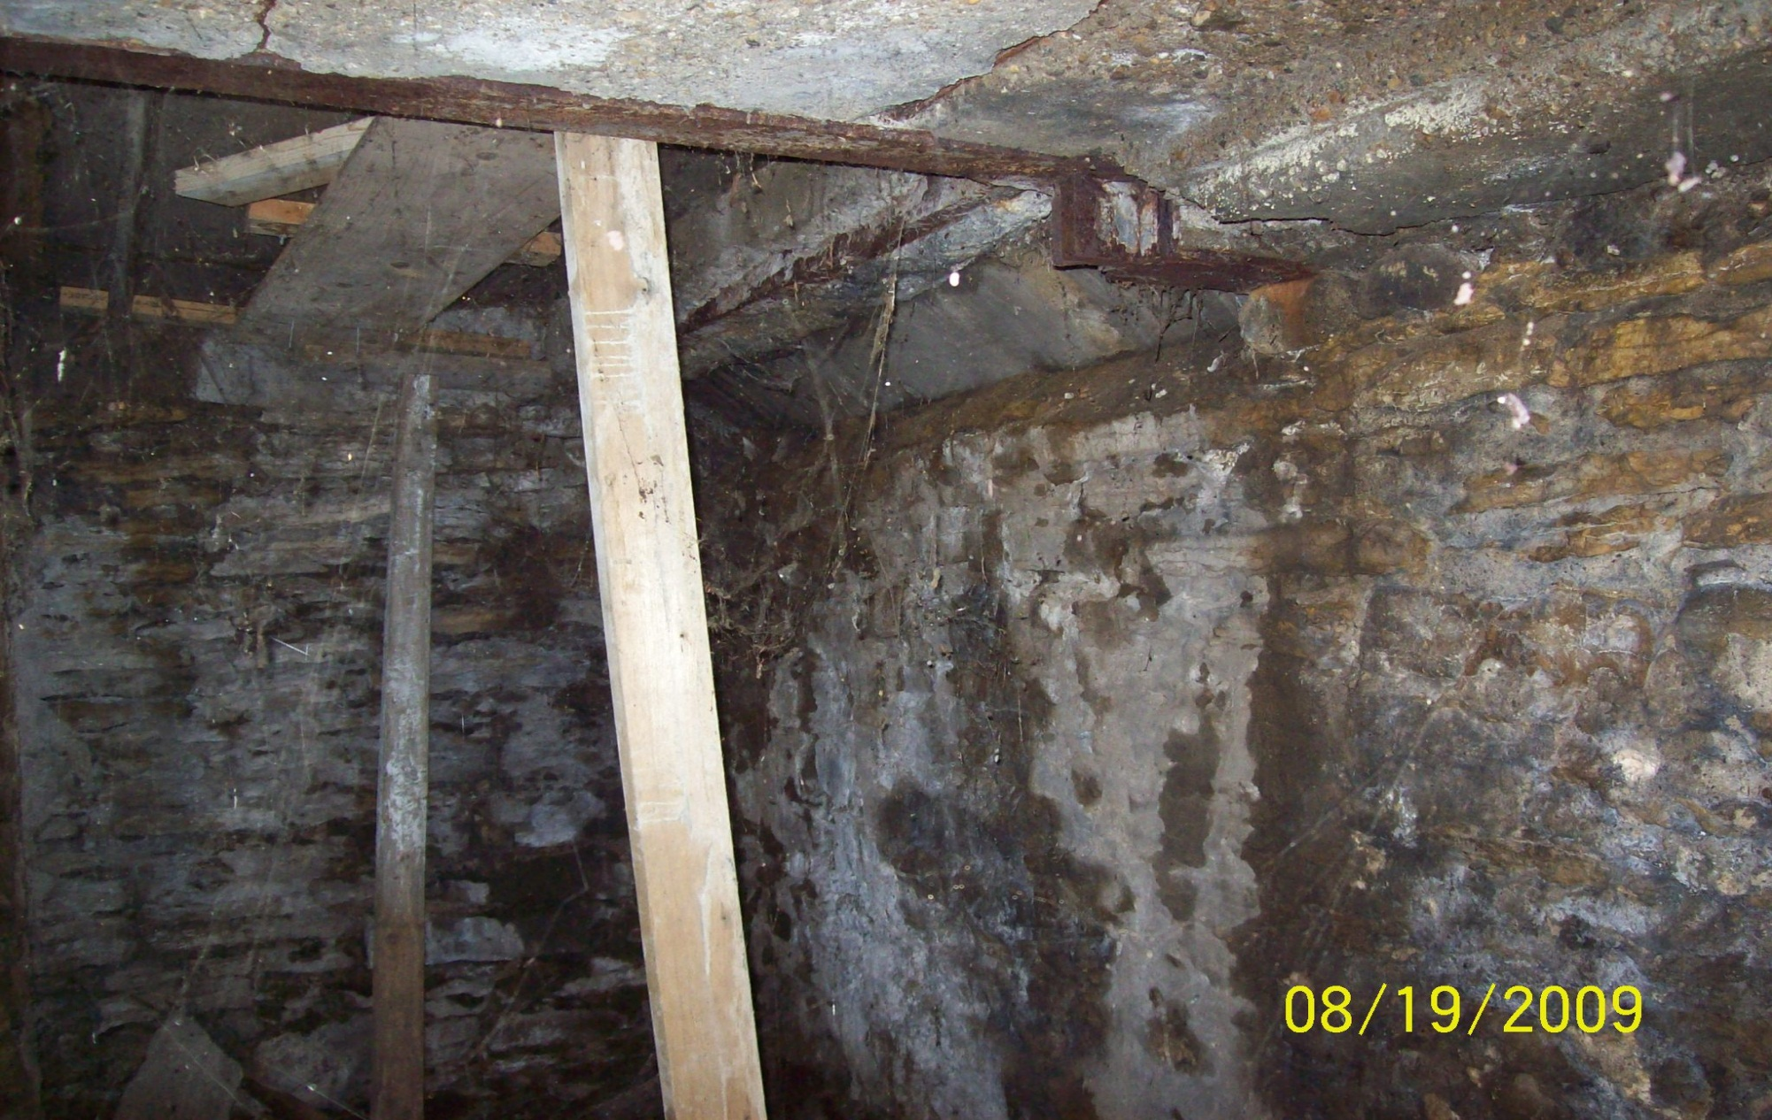
Mysteries Under the Sidewalks

Slide 25
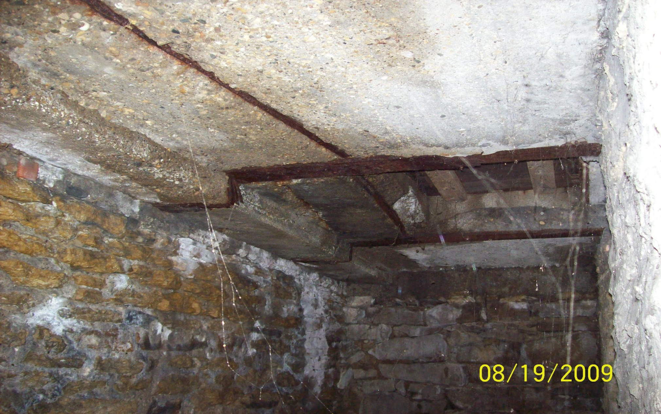
Mysteries Under the Sidewalks

Slide 26
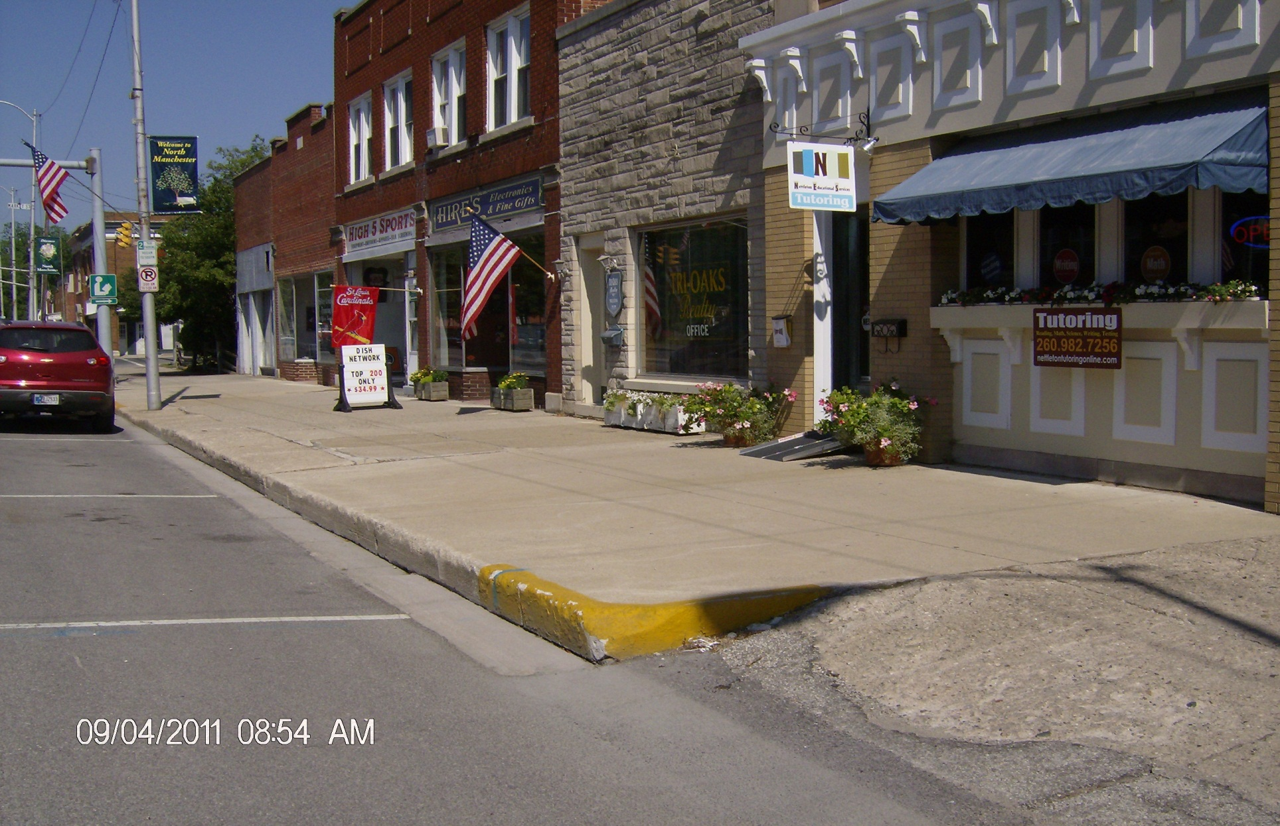
Building Entrances

Slide 27
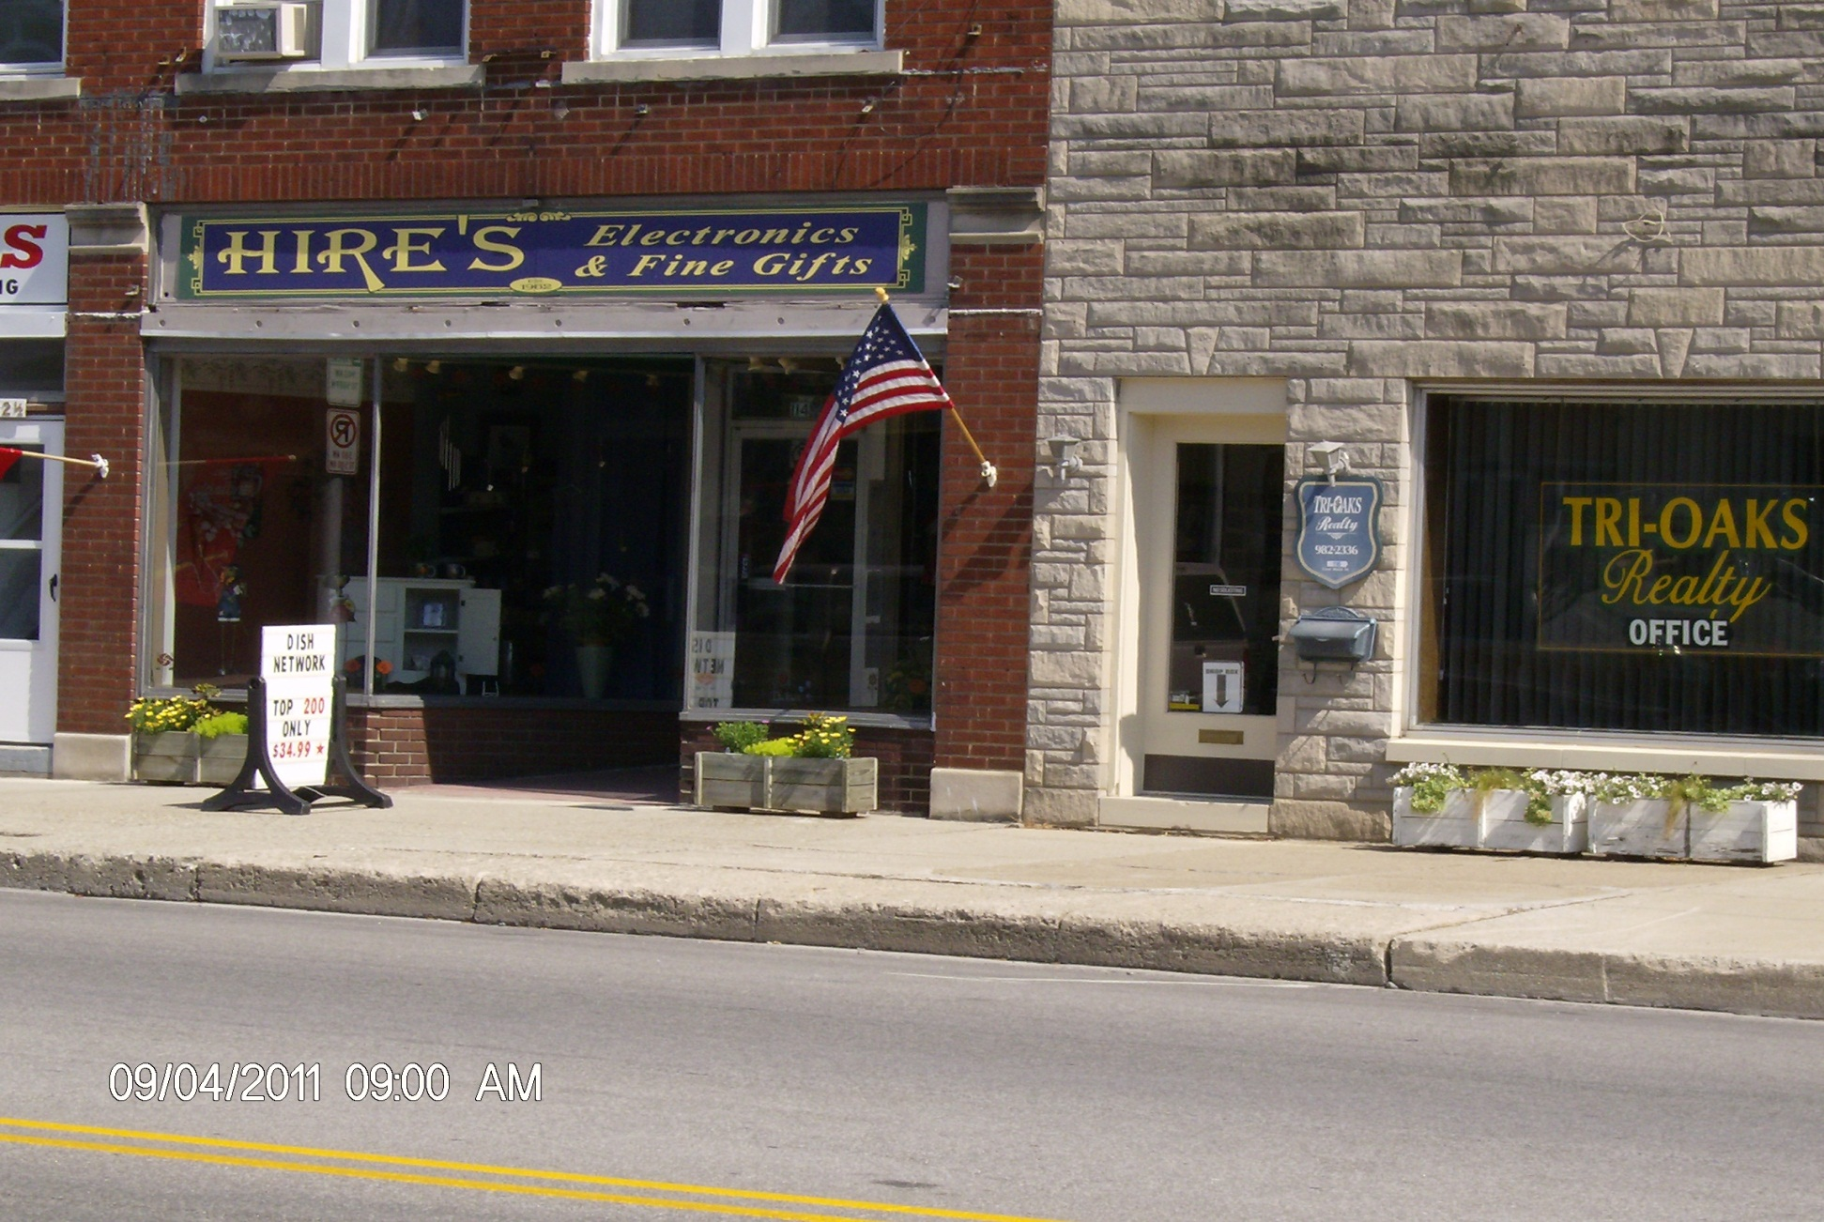
Building Entrances

Slide 28
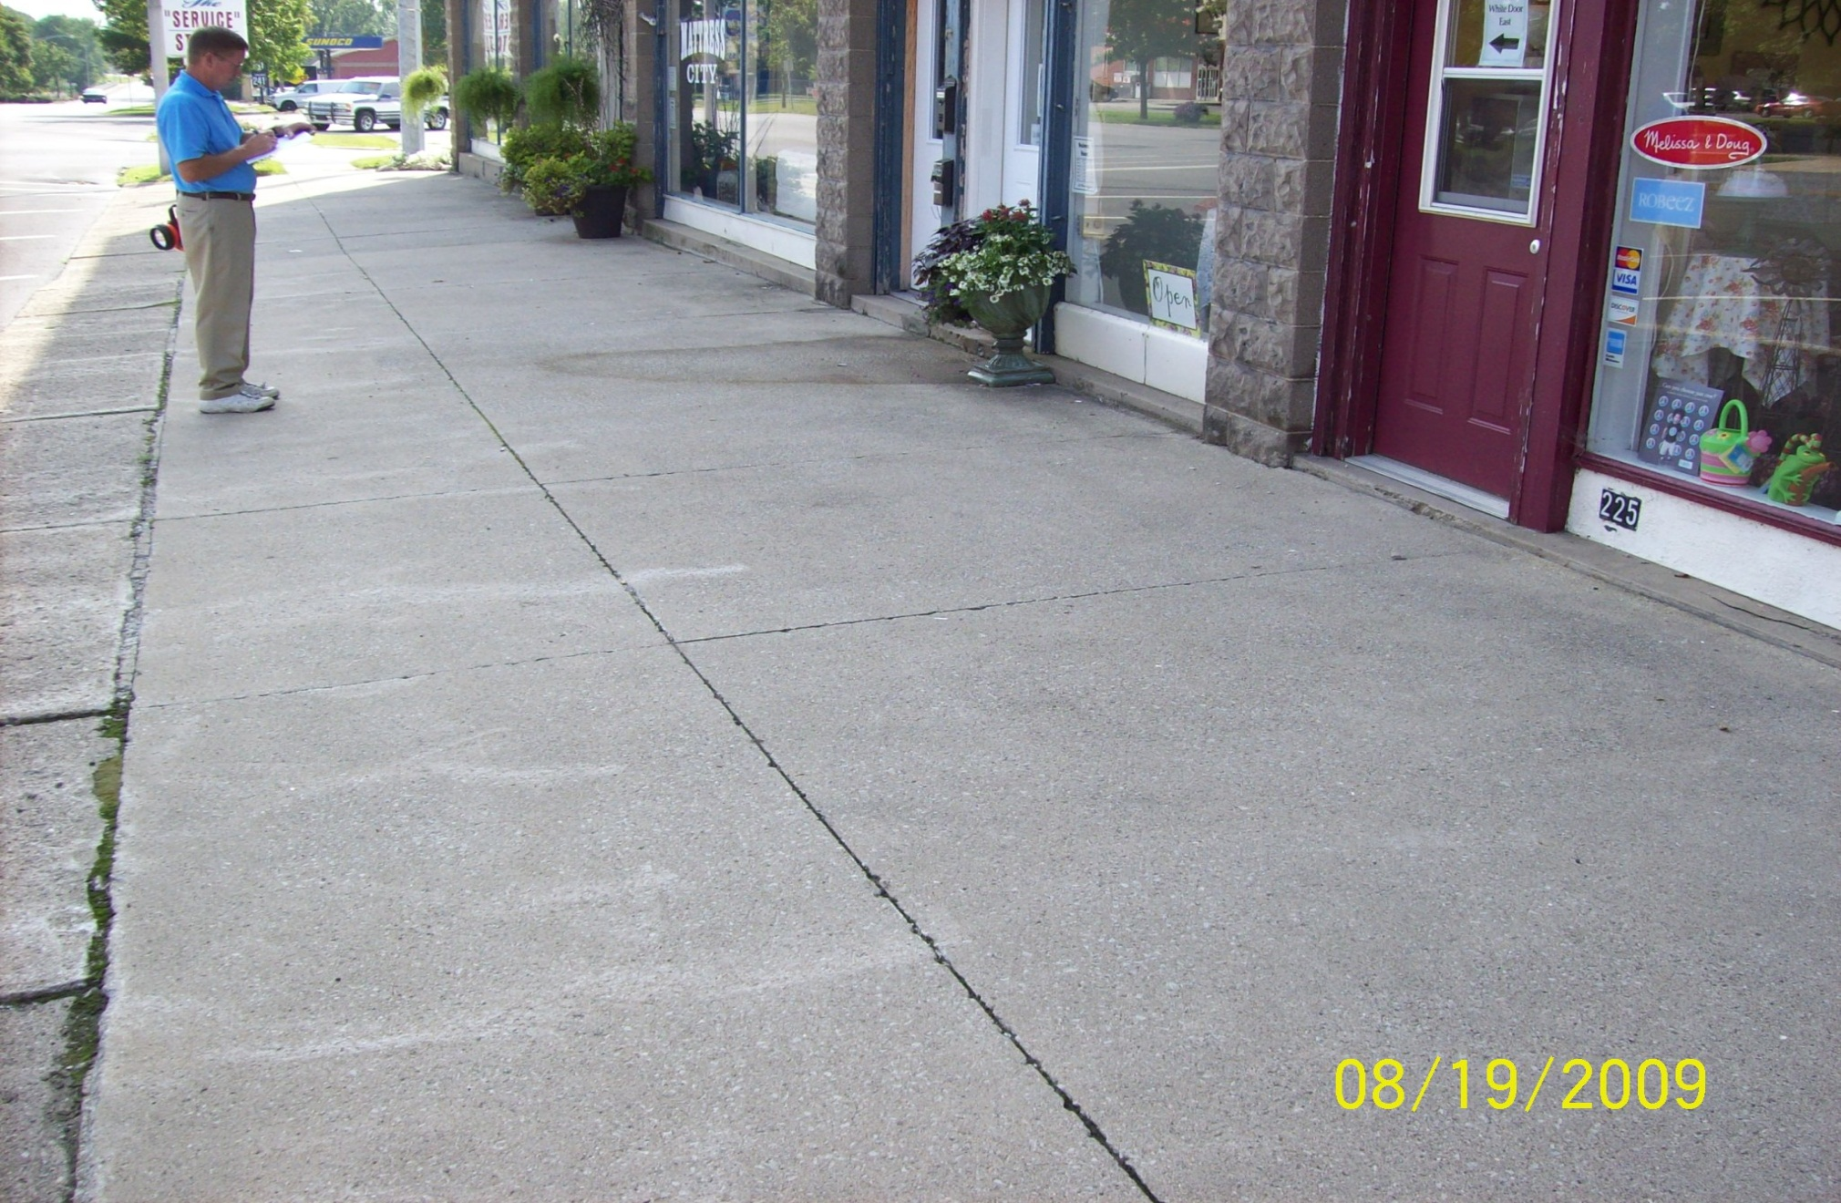
Sidewalk Elevations

Slide 29
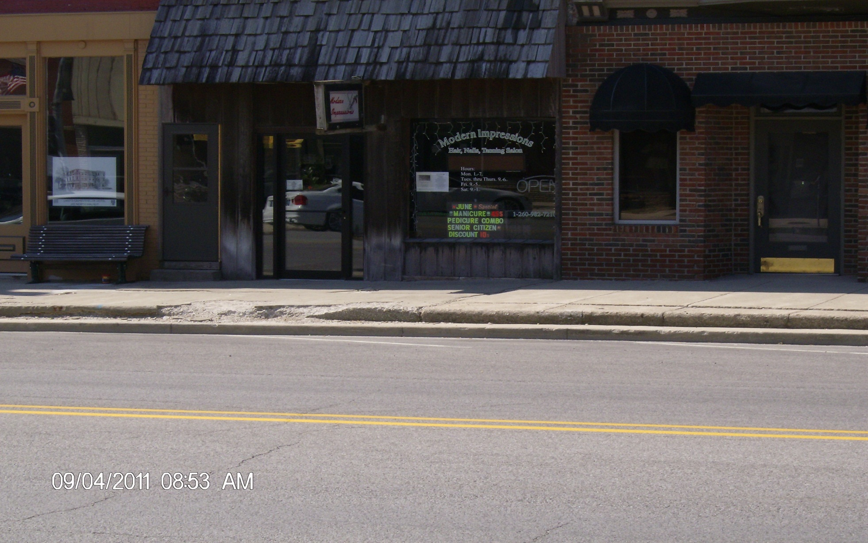
Curb Heights

Slide 30
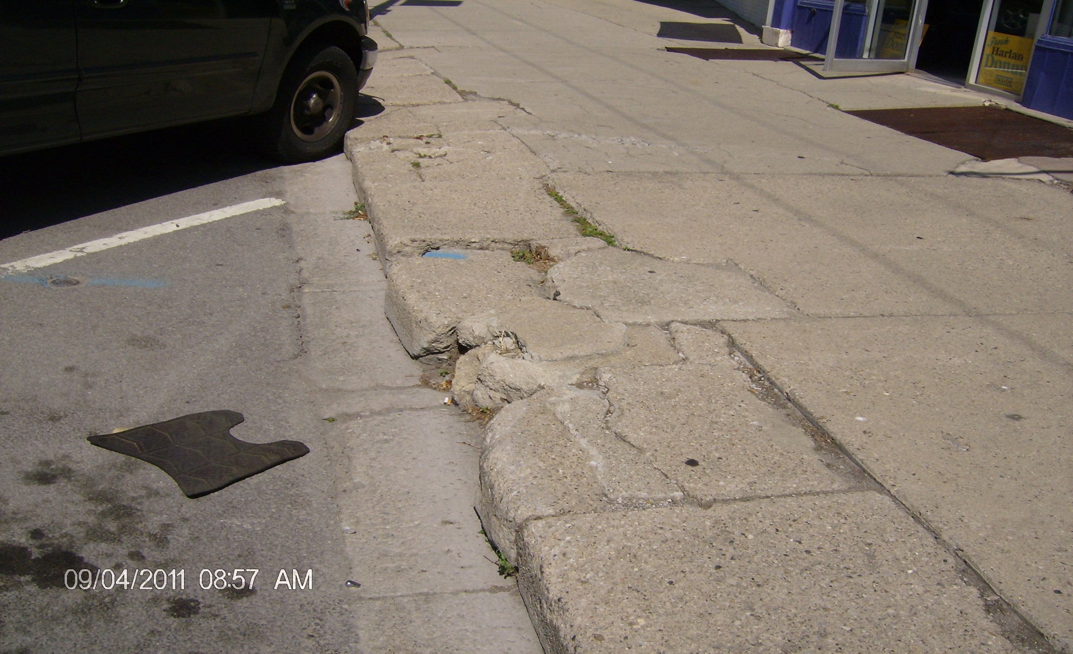
Current Conditions

Slide 31
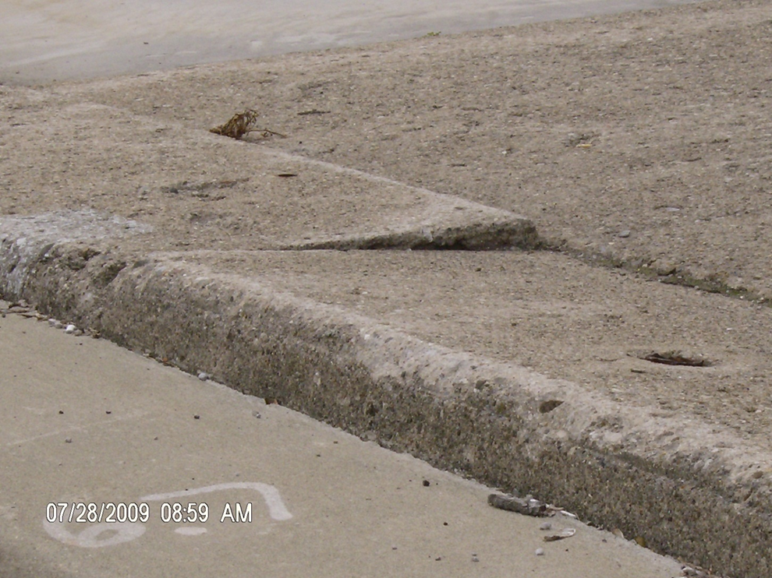
Current Conditions

Slide 32
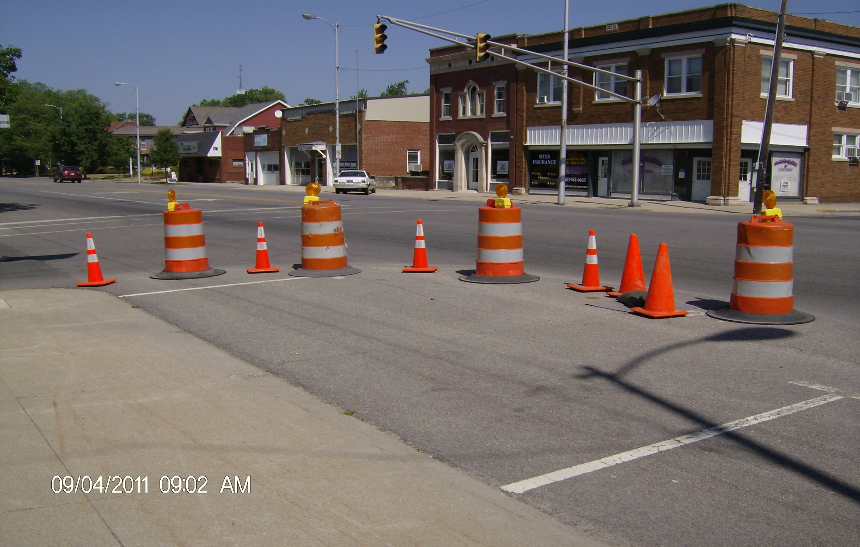
Hidden Surprises

Slide 33
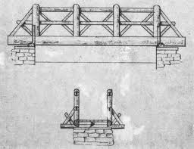
Customer Access During Construction

Slide 34
Construction Timeline
Construction Begins August 13
Optimistic Completion October 13
Realistic Completion November 13

Slide 35
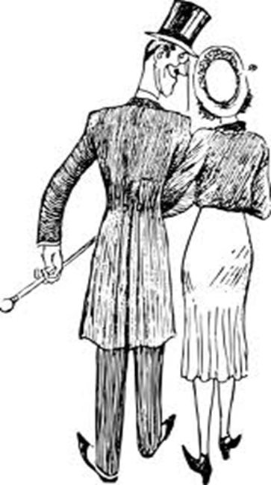
North Manchester Downtown Revitalization
Questions

